Slide 1
OpenCL tutorial

Slide 2
Outline
OpenCL Architecture
OpenCL memory buffer object
OpenCL program and kernel object
OpenCL synchronization and event object
OpenCL C programming
OpenCL 2.0 feature
  Shared virtual memory
  Device-side enqueuer kernel

Slide 3
OpenCL Architecture
What is OpenCL?
  Open industry standard for heterogeneous programming. Collection of computing devices organized into a single platform.
  A framework for parallel programming includes a language, API, libraries and a runtime system.
We will use a hierarchy of models to describe OpenCL framework
  Platform Model
  Memory Model
  Execution Model
  Programming model

Slide 4
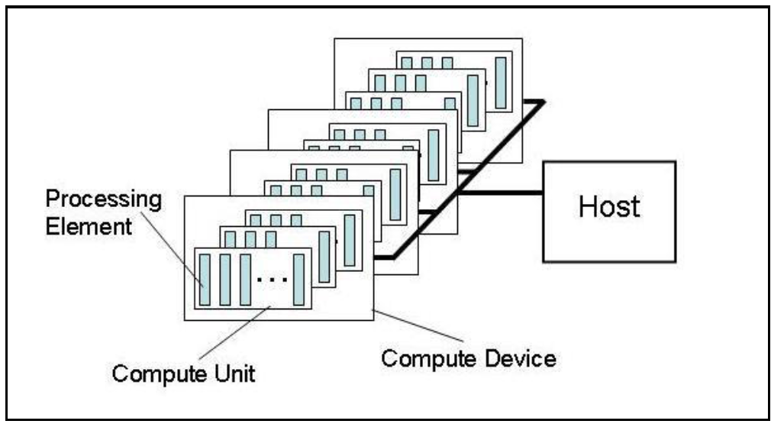
Platform model
An OpenCL Platform model consists of a host connected to one or more devices like CPU's, GPU's or hardware accelerators like DSP's.

Slide 5
Platform versions
OpenCL is designed to support devices with different capabilities under a single platform.
  Includes devices with different versions of the OpenCL specification.
  Needs to query the implementation about the supported version in the platform.
Platform Version: Indicates the version of the OpenCL runtime supported.
Device Version: Indicates the device capabilities and attributes. The conformant version info provided cannot be greater than platform version.

Slide 6
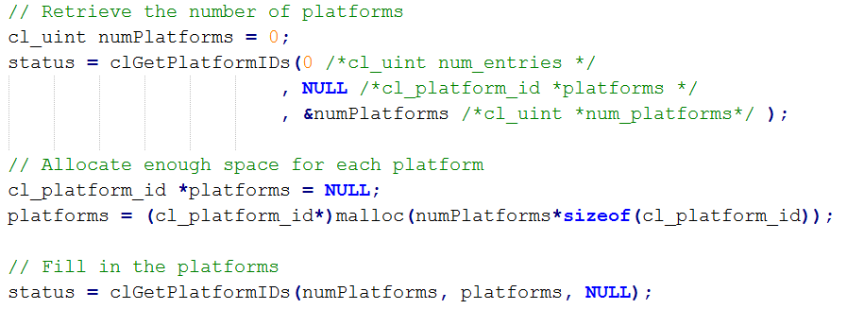
Query platforms
To query the platform versions and details of the OpenCL implementation, the following two APIs are used:
  cl_int clGetPlatformIDs
  cl_int clGetPlatformInfo

Slide 7
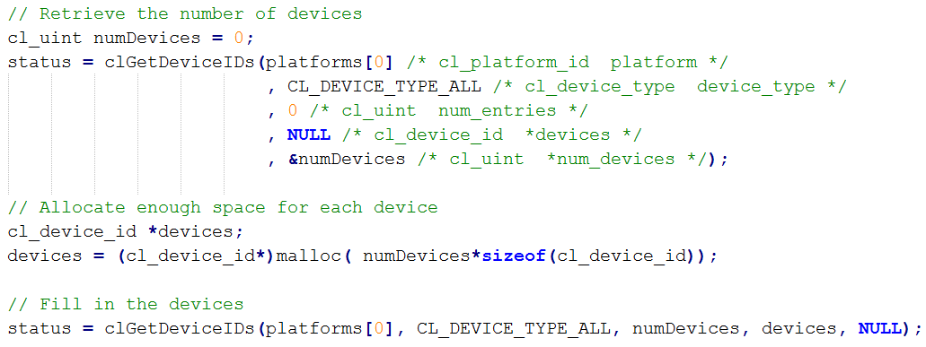
Query devices
To query the the attributes and resource limitations of an OpenCL device, the following two APIs are used:
  cl_int clGetDeviceIDs
  cl_int clGetDeviceInfo

Slide 8
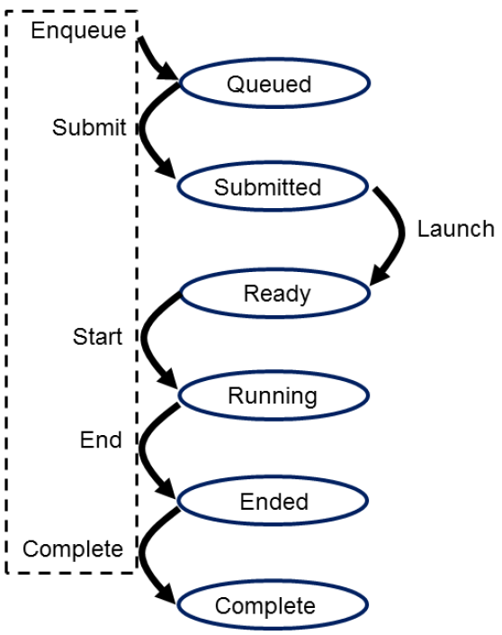
Execution model
The two main execution units in OpenCL are the kernels and the host program.
  The kernels execute on the so called OpenCL device.
  The host program runs on the host computer.
The main purpose of the host program is
  Create and query the platform and device attributes,
  Define a context for the kernels,
  Build the kernel
  Manage the execution of these kernels.

Slide 9
NDRange
An NDRange is the kernel execution index in an N-dimensional index space.
  The values which N can take are 1, 2, or 3.
Work-item -> Work-group -> NDRange
We will be using the following terms for defining the Execution model:
  work-item: It is the individual kernel execution instance
  work-group: It is a group of work items form a work group
  global-id: A unique global ID given to each work item in the global NDRange
  local-id: A unique local ID given to each work item within a work group

Slide 10
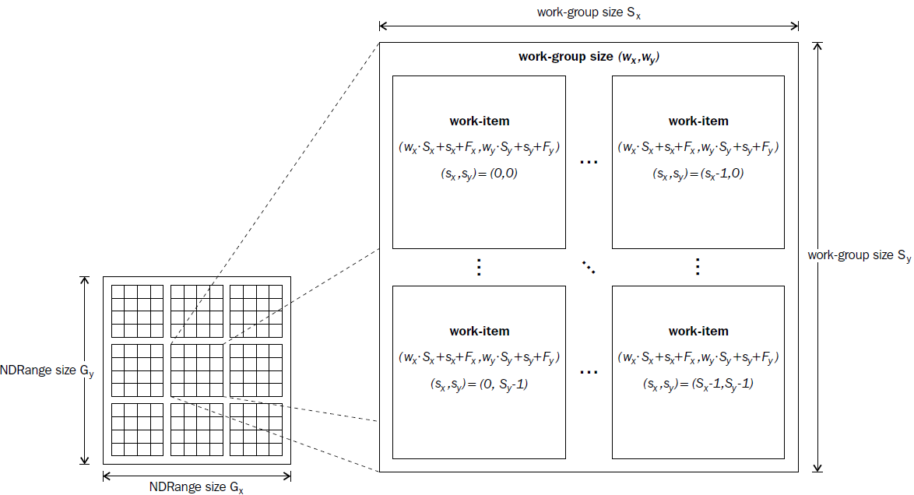
NDRange
the size of each work-group (Sx, Sy)
the global ID offset (Fx, Fy).

Slide 11
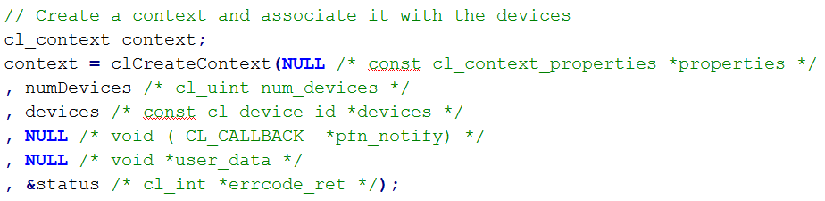
OpenCL context
A context defines the entire OpenCL environment,
  OpenCL devices
  Program objects,
  OpenCL kernels,
  OpenCL memory objects
  OpenCL command queues
This function creates a context given a list of devices
  cl_context clCreateContext

Slide 12
OpenCL command queue
A command queue is the mechanism for the host to request that an action be performed by the device.
  These commands can be of data transfer, or
  Kernel execution commands or
  Barriers within the command queue.
Queues can be in-order of the execution queues or out-of-order queues.
We use the API to create command queue.
  cl_command_queue clCreateCommandQueue

Slide 13
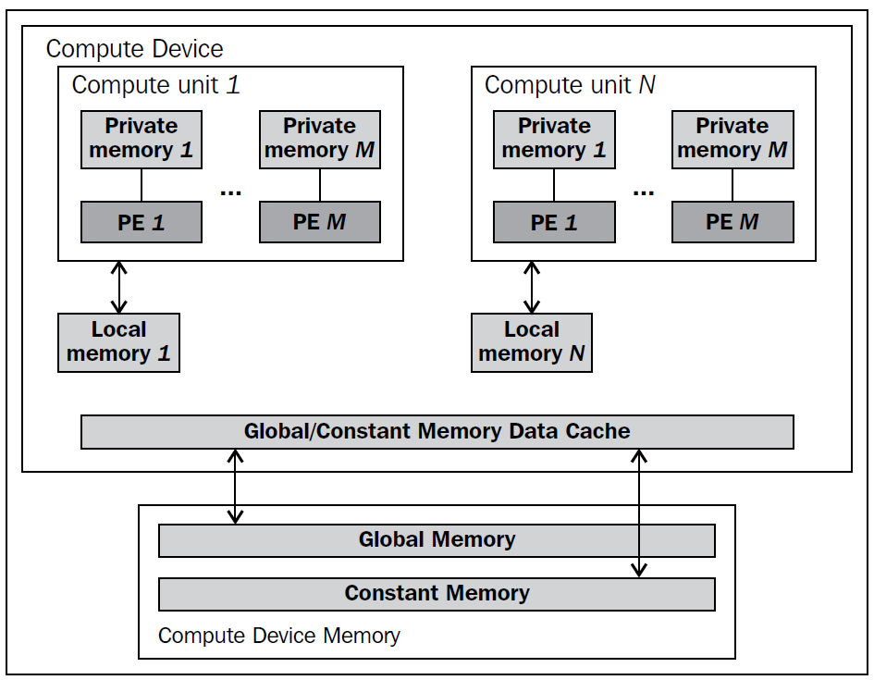
Memory model
Device part
Host part
Host memory

Slide 14
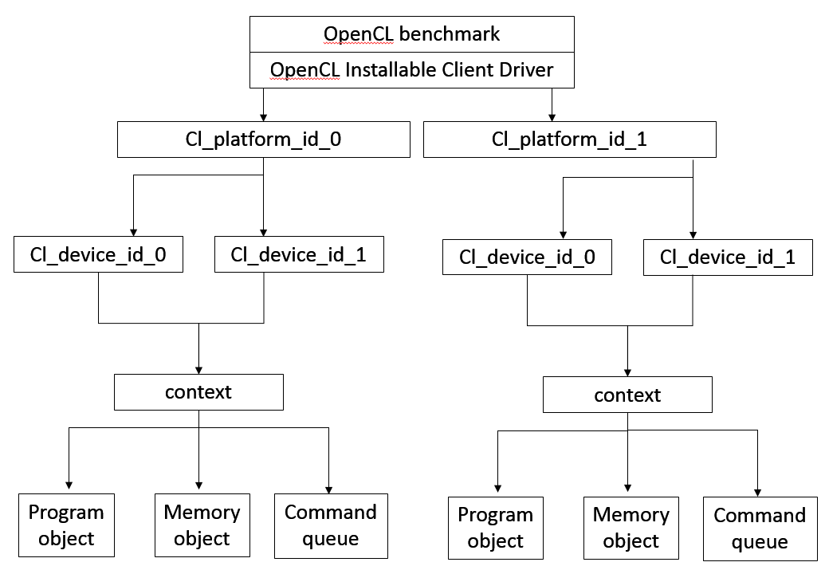
Installable Client Driver
The OpenCL Installable Client Driver (ICD) allows multiple OpenCL implementations to co-exist and applications to select between them at runtime.

Slide 15
Basic OpenCL program
Platform information
Device information
Context
Command queue
Read(Write) buffer
  Write: host->device Read: device->host
Kernel
  Create program with source(binary) , build program, kernel argument
N-Dimension Range kernel
  Assign work-group, work-item

Slide 16
OpenCL Buffer Objects
OpenCL buffer memory object is referred to as the cl_mem.
We will introduce how to do the following things.
  Create buffer objects
  Transferring the buffer data to and from the device
  Mapping and querying the buffer objects

Slide 17
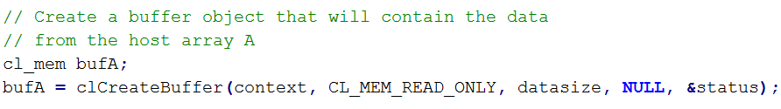
Memory objects
Memory objects are encapsulated by cl_mem data structure.
The functions is used to create a memory object.
  cl_mem clCreateBuffer
The functions return the cl_mem objects and the type of memory is specified by the flags variable of type cl_mem_flags.
  CL_MEM_READ_WRITE
  CL_MEM_WRITE_ONLY
  CL_MEM_READ_ONLY
  …etc

Slide 18
Memory objects
The cl_mem_flags flag is applied bitwise OR to the different flag combinations.
  For example CL_MEM_READ_WRITE |CL_MEM_USE_HOST_PTR
But each combination is restricted by the flag definition.
The cl_mem_flags flag specification specifies some mutually exclusive combinations.
  For example (CL_MEM_USE_HOST_PTR |CL_MEM_COPY_HOST_PTR) is not possible
  CL_MEM_COPY_HOST_PTR flag allocates memory at the device and copies the data pointed to by the host pointer.
  CL_MEM_USE_HOST_PTR flag does not allocate any memory at the device

Slide 19
Read and write buffers
Before the kernel is launched you can use the API to write the buffer to the device memory.
  cl_int clEnqueueWriteBuffer
  Writes data from the host to the device memory.
Get the buffer back to the host from the device memory, you can use the API.
  cl_int clEnqueueReadBuffer
  Reads data from the device to the host memory.

Slide 20
Copying buffers
The following two functions enable the application to copy data between two OpenCL buffer objects.
  cl_int clEnqueueCopyBuffer
  cl_intclEnqueueCopyBufferRect
  same as reading the buffer back from and then writing it back to a destination
clEnqueueCopyBuffer copies the data between two cl_mem objects directly in the device memory or through the device memory interface across two devices.

Slide 21
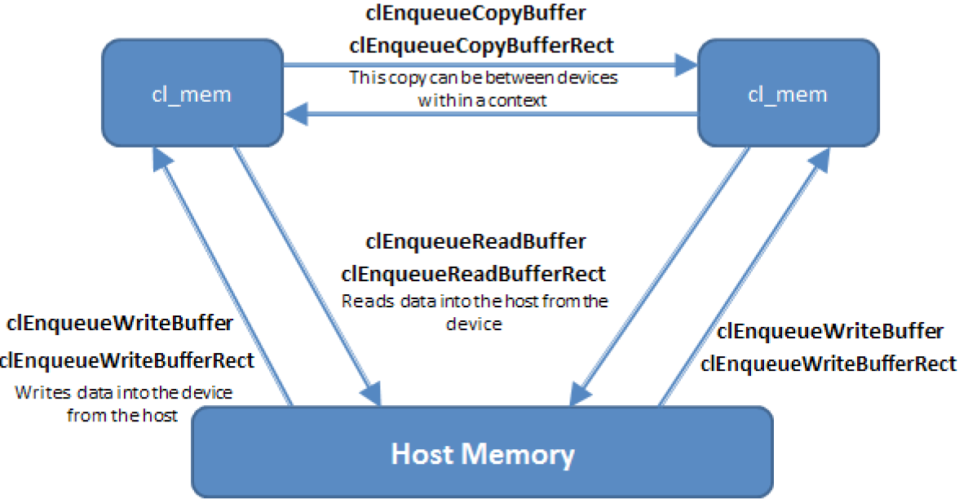
Copying buffers

Slide 22
Mapping buffer objects
OpenCL provides a mechanism to map a region of a buffer directly into host memory instead of using the clEnqueueXXXBuffer functions.
  void * clEnqueueMapBuffer
We can use this mapped memory region based on the cl_map_flags flag value which is set during mapping.
The different between the two APIs clEnqueueMapBuffer and clEnqueueReadBuffer?
  The clEnqueueReadBuffer function reads into a memory location pre-allocated.
  clEnqueueMapBuffer returns a pointer to the mapped region.

Slide 23
Mapping buffer objects
Same as clEnqueueReadBuffer, in clEnqueueMapBuffer if map_flags.
  set to CL_MAP_READ, the mapped memory will be read only
  set as CL_MAP_WRITE the mapped memory will be write only
We can also combine two map_flags together.
  For example CL_MAP_READ|CL_MAP_WRITE
The clEnqueueMapBuffer function returns a pointer to the mapped host memory. This memory can later be unmapped using the function
  cl_int clEnqueueUnmapMemObject

Slide 24
OpenCL Program and Kernel Objects
Kernel and program object are the important execution entities in the OpenCL framework.
In this chapter we will introduce the set up steps required to create a program object and execute a kernel.
The following topics will be discussed in this next slides:
  Creating and build program objects
  Creating Kernel objects
  Offline and online compilation
  Setting kernel arguments and executing kernels
  Source versus binary program creation

Slide 25

Creating program objects
An OpenCL application can execute a function in parallel on a device using the kernel objects.
Each kernel in a program source string is identified by a __kernel qualifier.
Program object can be created using the functions
  cl_program clCreateProgramWithSource
  cl_program clCreateProgramWithBinary

Slide 26

Creating program objects
Once a new program object is created for a, the next step is to build the program.
The clBuildProgram function builds an OpenCL program.
  cl_int clBuildProgram
Note that although you create a program using binary source files you need to again build the program object using the clBuildProgram API.
  Because the clBuildProgram function acts like a linking step.

Slide 27
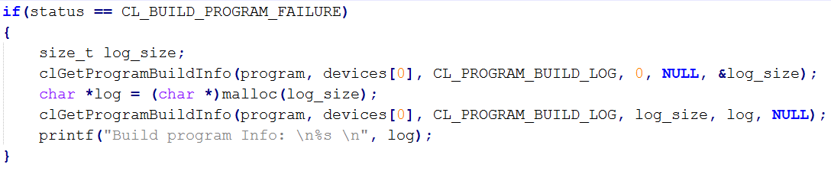
Building program object
Once a program is successfully built, we can get a binary file using the clGetProgramInfo function with the param_name, CL_PROGRAM_BINARIES.
What about if there is a compilation error
  OpenCL implementation returns CL_BUILD_PROGRAM_FAILURE for the call to clBuildProgram.
We can use this function to look for the compilation error and get the build error log.
  cl_int clGetProgramBuildInfo

Slide 28
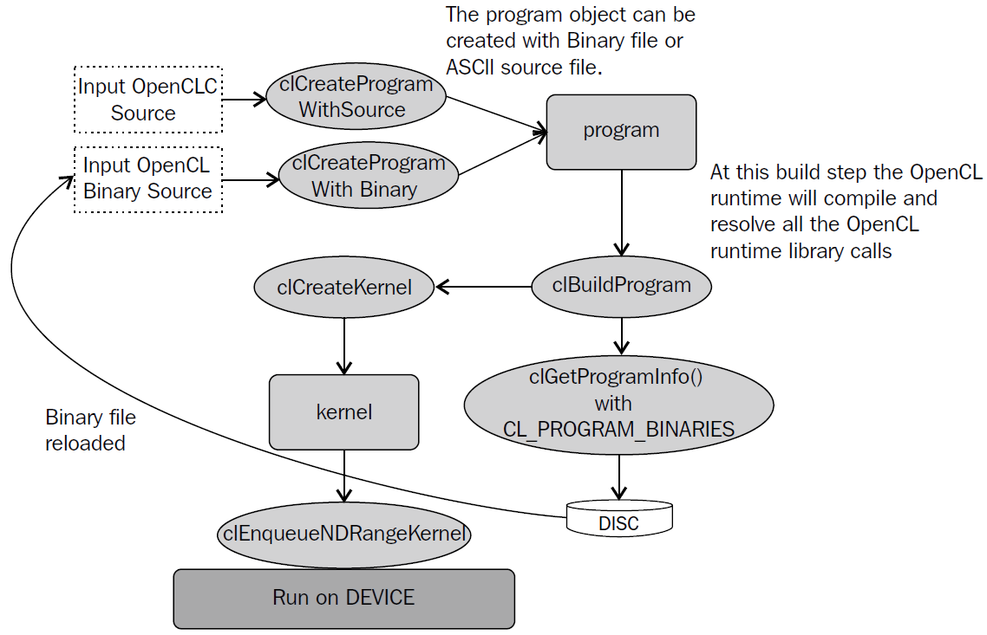
Steps to create a progam object

Slide 29
Offline and online compilation
OpenCL kernel can be created at runtime, this is referred to as online compilation.
We can store this kernel binary in the form of a library and an application can load it on demand from the disk. This is referred to as offline compilation.

Slide 30
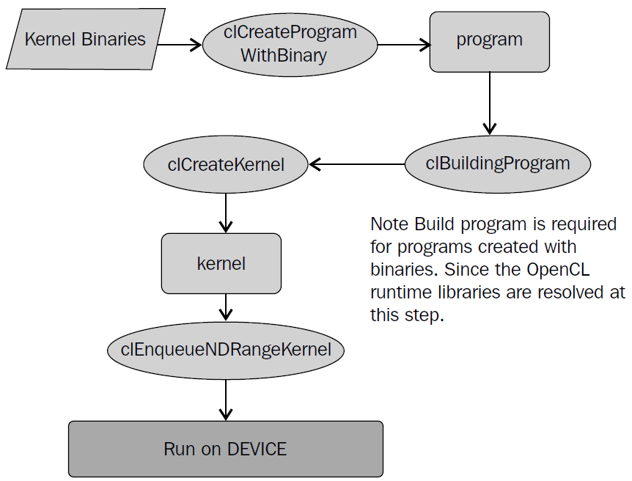
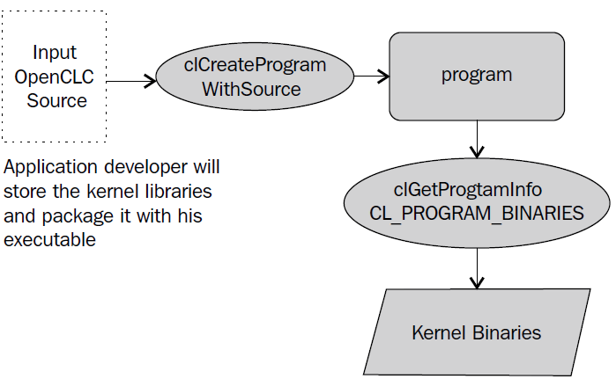
Offline compilation

Slide 31
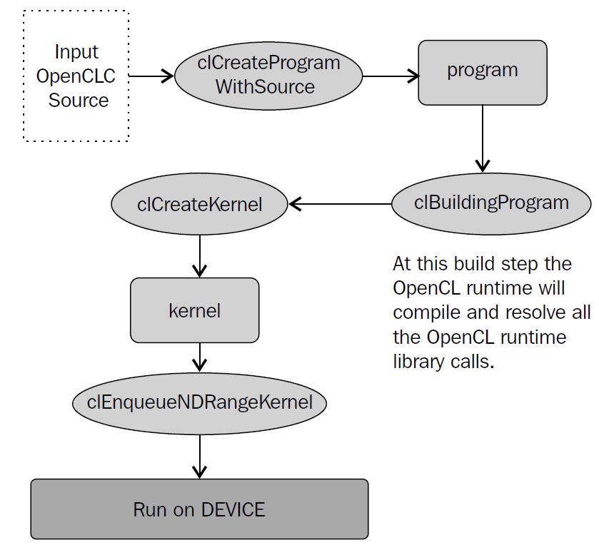
Online compilation

Slide 32
Creating kernel objects
Every program is a collection of kernels, you can consider a program object as a library of kernels.
A kernel when enqueued on the command queue, the OpenCL runtime generates the binary for execution on the device.
Program Object
Kernel
Kernel
Kernel
Kernel

Slide 33
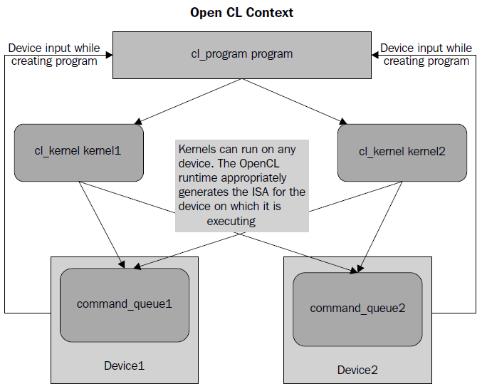
Creating kernel objects
As shown in the following figure a program is associated with kernel1 and kernel2.
The program is built with inputs as two devices device1 and device2.

Slide 34

Creating kernel objects
Each kernel in an OpenCL C code is identified by the __kernel function keyword.
In the OpenCL programs the cl_kernel objects are created using the clCreateKernel function.
  cl_kernel clCreateKernel
There is another mechanism with which kernels can be created all the kernel objects ssociated with the program.
  cl_kernel clCreateKernelsInProgram

Slide 35
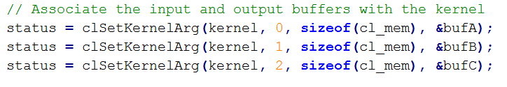
Setting kernel arguments
Before executing the kernel, the arguments must be set for the kernel using the function.
  cl_int clSetKernelArg
If the associated kernel argument is a __global or __constant memory qualifier then this argument will be NULL while the kernel is executed.
If the argument is a __local address space qualifier the arg_value has to be NULL. The __local address space qualifier specifies a local memory in the device. This memory need not be allocated on the host, hence it is NULL.

Slide 36
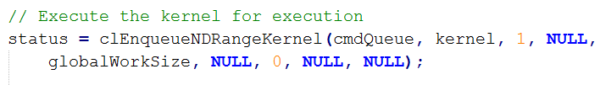
Executing the kernels
The created cl_kernel object can now be run on the device associated with it using the API.
  cl_int clEnqueueNDRangeKernel
This shall enqueue the command for kernel execution on the command_queue.
There is one other way with which a kernel can be executed. If clEnqueueNDRange is available for data parallel workloads then This is available for task parallel workloads.
  cl_int clEnqueueTask

Slide 37
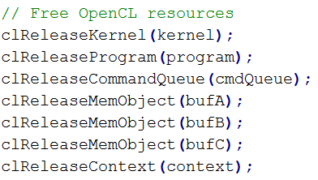
Releasing program and kernel objects
Every program object needs to be released from the OpenCL implementation space. This is achieved by using the following function.
  cl_int clReleaseProgram
The call to clReleaseProgram function will decrement a reference count, and if the count reaches 0, then the program object is released.
Similar to program objects kernel objects can also be released using
  cl_int clReleaseKernel

Slide 38
Events and Synchronization
In OpenCl tasks will be queued on to a device command queue.
  May need to keep track of these tasks and synchronize the data view for a computational task.
The OpenCL standard provides this synchronizing entity in the form of cl_event objects.
Events as an action that is usually initiated outside the scope of a program and the status of these events is handled by a piece of code inside the program.

Slide 39
Events and Synchronization
A typical source of event handle is the OpenCL clEnqueueXXX routines. An OpenCL runtime libraries changes the state of all events enqueued to the command queue.
  It keeps track of all the operations, which a host program initiates on to the various OpenCL devices
In next slides we shall discuss about the following topics:
  Coarse-grained events
  Fine-grained events
  Various synchronization models

Slide 40
Events and Synchronization
For "coarse grained" synchronization, OpenCL provides functions such as, clFlush,and clFinish.
When the need arises for "finer grained" synchronization, the OpenCL specification provides a cl_event object.
The cl_event object helps to identify the status of unique commands in a queue and thus enable a host level monitoring of each event.

Slide 41
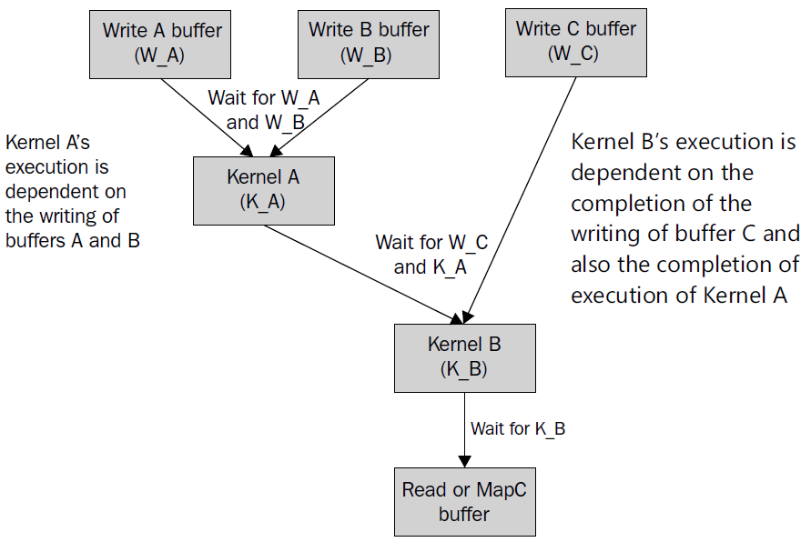
Events and Synchronization
Have a look at the following diagram. Execution of the kernel A is dependent on two write events of buffers A and B to complete.
Similarly kernel B can be executed only when write of buffer C is completed and the execution of kernel A is also completed

Slide 42
Events and Synchronization
You can make sure that queue has dequeued all the commands and every command is completed by calling clFinish. The clFinish function will block the host program until the entire queue has completed.
An OpenCL program can also wait for a list of events to finish with clWaitForEvents. This is also a host blocking call but the developer has a control on the events on which he wants to wait for instead of the all the events in the command_queue queue.
And if you don't want to stop the host execution then use clEnqueueBarrierWithWaitList and clEnqueueMarkerWithWaitList.

Slide 43
OpenCL events and monitoring
An event is a cl_event object that forms a medium of communication between the application and the OpenCL implementation.
  This monitoring can be of data transfer between the host and the devices or either for the execution of the NDRange kernel.
During command synchronization, a command which is queued for execution will wait on a list of events to complete before executing itself.

Slide 44
OpenCL events and monitoring
For example, clEnqueueXXX have to wait for event_wait_list events before finally executing itself.
  These event wait lists can be used to wait on one or more than one command.
On return of this function the last parameter event shall contain the handle to the cl_event object for the task being enqueued. This handle can be used to keep track of the execution of the command which is being queued.

Slide 45
OpenCL events and monitoring
In OpenCL we can use events in three main ways which are follows:
  Host notification: An event can notify the host that a command has completed its execution on a device
  Command synchronization: An event can force commands to delay their execution until another event's occurrence has taken place
  Profiling: An event can monitor how much time a command takes to execute

Slide 46
OpenCL event synchronization models
The queuing of the command takes place in-order or as the program flow occurs. But when the commands are dequeued the tasks can execute in-order or out-of-order.
  In ordered execution one does not need an explicit synchronization.
  out-of-order execution, there is a need for synchronization.
  Synchronization is needed in the case of multiple command queues also.

Slide 47
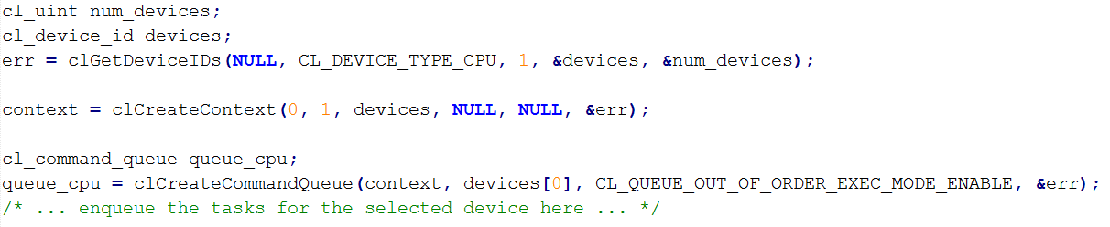
Single device and out-of-order queue
In this case we use an out-of-order queue, which is also associated with a single device in a context, same as the previous. All the memory operations occur in a single memory pool. All the commands will execute in a single device, but the order in which the commands get dequeued will have no guarantee for an ordered execution.

Slide 48
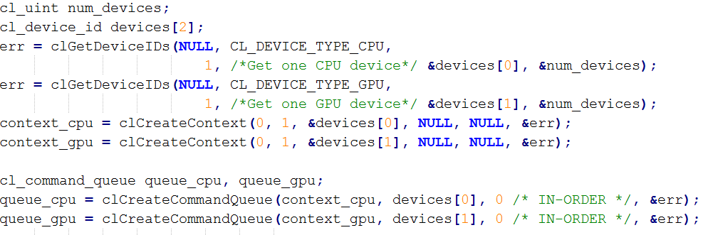
Multiple devices and multiple contexts
Here the commands execute on separate devices associated with a queue and each device has a separate memory pool. This model is useful if there are multiple devices in the platform and one wants to divide and run separate algorithms in different devices.

Slide 49
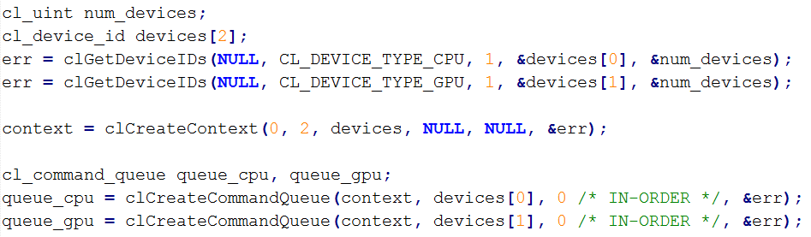
Multiple devices and single context
Multiple devices in the platform belong to the same context and each device has an associated queue and will modify or read data from a combined memory pool.

Slide 50
Coarse-grained synchronization
There are two APIs which enable coarse-grained synchronization,
  clFlush
  clFinish
clFlush only guarantees that all queued commands to command_queue get issued to the appropriate device.
  There is no guarantee that they will be complete after clFlush returns
clFinish is a blocking function, that means clFinish will not return until all the previously enqueue commands in the command_queue are issued and reached its state of completion.

Slide 51
Event-based or fine-grained synchronization
These event handles identify the unique commands in the queue and can be used for synchronizing algorithm execution.
An OpenCL event state is defined as one of the following stages based on the life time of the task:
  CL_QUEUED
  CL_SUBMITTED
  CL_RUNNING
  CL_COMPLETE

Slide 52
Event-based or fine-grained synchronization
clEnqueueBarrier is a synchronization point that ensures that all queued commands in command_queue have finished execution before the next batch of commands can begin execution.
clEnqueueMarkerWithWaitList Enqueues a marker command which waits for either a list of events to complete, or all previously enqueued commands to complete.
  it does not stop the execution of subsequent tasks enqueued in the command queue.
clWaitForEvents This function waits on the host thread for commands identified by event objects in event_list to complete.

Slide 53
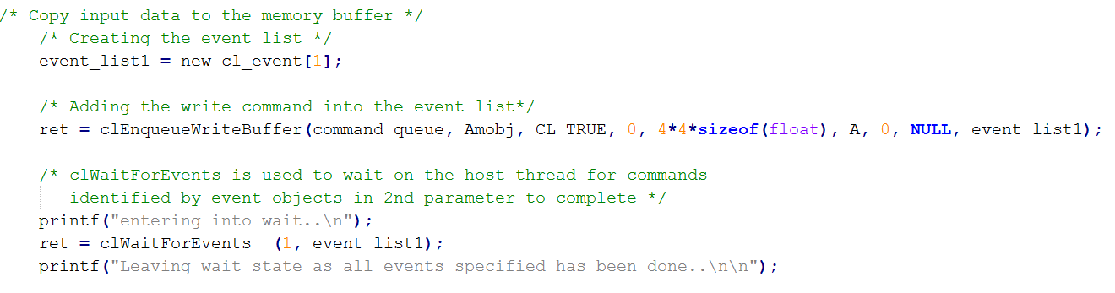
Event-based or fine-grained synchronization

Slide 54
Memory fences
OpenCL C specification provides for runtime barriers in a work item and across a single work group.
Barriers may only synchronize threads in the same workgroup.
  There is no way to synchronize between different work groups.
For synchronizing outside of the work group the kernel should complete its execution.
There are two types of memory fences:

Slide 55
Memory fences
CLK_LOCAL_MEM_FENCE: This ensures correct ordering of operations on local memory. It is used as follows:
  barrier(CLK_LOCAL_MEM_FENCE);
CLK_GLOBAL_MEM_FENCE: This ensures correct ordering of operations on global memory. It is used as follows:
  barrier(CLK_GLOBAL_MEM_FENCE);
Sometimes both can be used together as shown in the following code. This will help in debugging, or the algorithm uses both the global and local memory:
  barrier(CLK_LOCAL_MEM_FENCE | CLK_GLOBAL_MEM_FENCE);

Slide 56
OpenCL C Programming
OpenCL C language specification is based out of the C99 standard.
A compliant C kernel code is compiled by the OpenCL runtime compiler using the clBuildProgram function.
we will discuss the specifications and restrictions for writing an OpenCL compliant C kernel code. The following bullet list states the topics which will be discussed in this chapter:
  Built-in data types
  Conversions and type casting
  Address space qualifiers
  Function qualifiers
  Built-in functions

Slide 57
Data types
Please refer the spec.

Slide 58
Address space qualifiers
There are four different address space qualifiers supported by OpenCL.
  __global or global
  __local or local
  __constant or constant
  __private or private
The address space qualifier is used in variable declarations to specify the region of memory to allocate the declared object.

Slide 59
__global/global address space
The __global or global address space name is used to refer to memory objects allocated from the global memory pool.
All the memory usually gets allocated at the host side, and is passed to the kernel as a cl_mem object created using the clCreateBuffer function.
The const qualifier can also be added to the __global qualifier to specify that the memory object is read only.

Slide 60
__local/local address space
This memory address space specifier is allocated space in local memory of the computing device.
It can be shared across all the work items in a work group.
The variables or memory objects created with __local address space qualifier,have life time only till the execution of the work group executing the kernel. The

Slide 61
__constant/constant address space
The __constant or constant address space name is used to describe variables allocated in global memory and which are accessed inside a kernel(s) as read-only variables and can be accessed by all the global work item of the kernels during its execution.
Pointers to __constant variable are allowed inside the kernel and can be passed as an argument to the kernel. String literals are allocated __constant address space.
All program scope variables get defined in the __constant address space.
  This means that these variables need to be initialized and must be resolved during compile time.

Slide 62
__private/private address space
All the kernel arguments which do not specify any qualifier are by default treated as __private address space qualifiers.
Similarly all variables inside non-kernel and kernel functions are in the __private or private address space.
Pointer arguments to kernel functions must be declared with any one of the address specifiers __global, __constant, or __local qualifier.
By default unless specified they will be assumed in the __private region.

Slide 63
Built-in functions
OpenCL C provides a huge set of built in functions, which can be used by the programmer for programming the OpenCL kernels.
Using built-in functions wherever possible may result in performance enhancement. Also this will make sure the code is portable across different vendors.

Slide 64
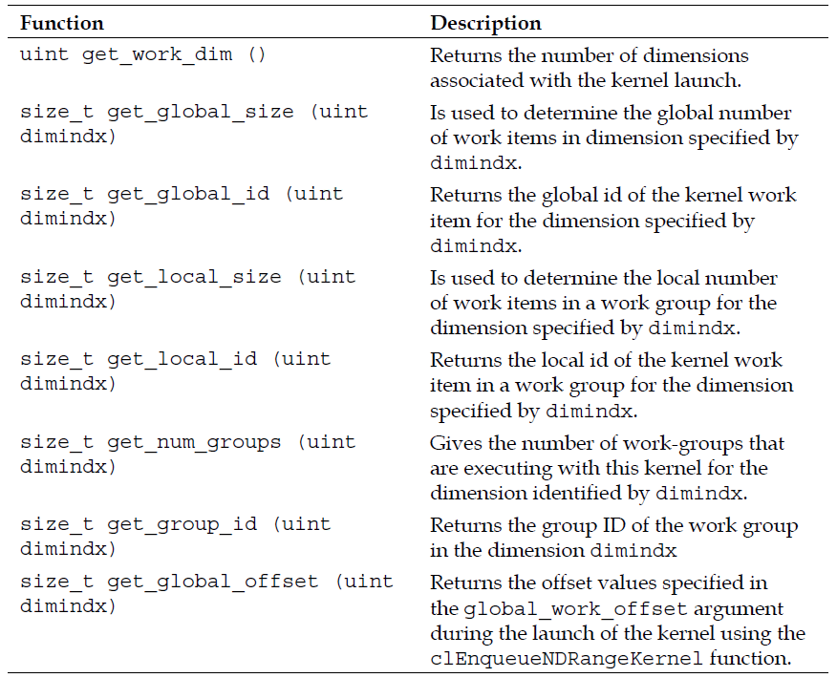
Work item function

Slide 65
Synchronization and memory fence functions
Most of the highly parallel OpenCL devices run all the work items in a work group in tandem that is all the work items run the same program counter instruction at the same time.
OpenCL C provides the barrier routine to stop the execution of a work item, till to until all the work items in that work group reach the same execution point.

Slide 66
Synchronization and memory fence functions
The barrier function will either flush any variables stored in local memory or queue a memory fence to ensure correct ordering of memory operations to local memory.
CLK_LOCAL_MEM_FENCE—this ensures correct ordering of operations on local memory. It is used as follows:
  barrier(CLK_LOCAL_MEM_FENCE);
CLK_GLOBAL_MEM_FENCE—this ensures correct ordering of operations on globalmemory. It is used as follows:
  barrier(CLK_GLOBAL_MEM_FENCE);

Slide 67
Shared Virtual Memory
In OpenCL 1.2 buffer objects can only be passed as kernel arguments
Buffer object described as pointer to type in kernel
Restrictions
  Pass a pointer + offset as argument value
  Store pointers in buffer object(s)
Why?
  Host and OpenCL device may not share the same virtual address space
  No guarantee that the same virtual address will be used for a kernel argument across multiple enqueues

Slide 68
Shared Virtual Memory
clSVMAlloc – allocates a shared virtual memory buffer
  Specify size in bytes
  Specify usage information
  Optional alignment value
SVM pointer can be shared by the host and OpenCL device
Examples
Free SVM buffers
  clEnqueueSVMFree, clSVMFree

Slide 69
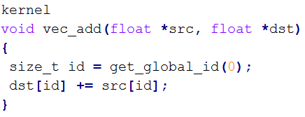
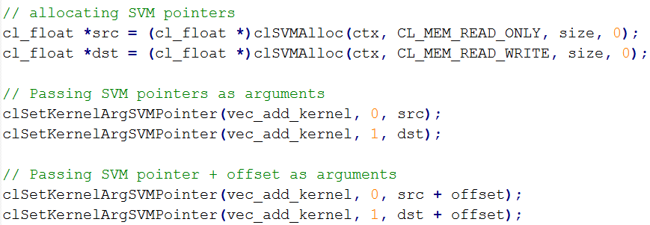
Shared Virtual Memory
clSetKernelArgSVMPointer
  SVM pointers as kernel arguments
  A SVM pointer
  A SVM pointer + offset

Slide 70
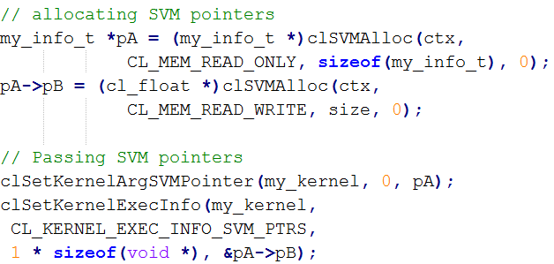
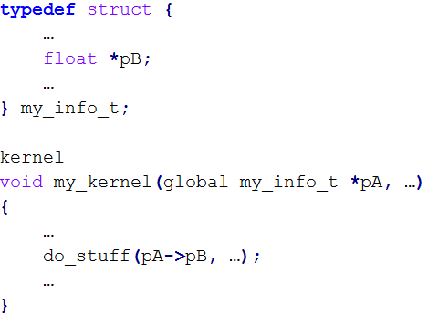
Shared Virtual Memory
clSetKernelExecInfo
  Passing SVM pointers in other SVM pointers or buffer objects

Slide 71
Device side enqueuer kernels
In OpenCL 1.2 only the host can enqueue kernels.
OpenCL 2.0 allows a kernel to independently enqueue to the same device, without host interaction.
Use similar approach to how host queues commands
  Queues and Events
  Functions that queue kernels and other commands
  Event and Profiling functions

Slide 72
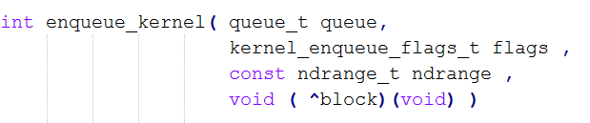
Device side enqueuer kernels
The enqueue_kernel built-in function allows a work-item to enqueue a block.
  Work-items can enqueue multiple blocks to a device queue(s).

Slide 73
Device side enqueuer kernels
CLK_ENQUEUE_FLAGS_NO_WAIT
  Indicates that the enqueued kernels do not need to wait for the parent kernel to finish execution before they begin execution.
CLK_ENQUEUE_FLAGS_WAIT_KERNEL
  Indicates that all work-items of the parent kernel must finish executing before the enqueued child kernel may begin execution.
CLK_ENQUEUE_FLAGS_WAIT_WORK_GROUP
  Indicates that the enqueued kernels wait only for the workgroup that enqueued the kernels to finish before they begin execution.
  This acts as a memory synchronization point between work-items in a work-group and child kernels enqueued by work-items in the work-group.

Slide 74
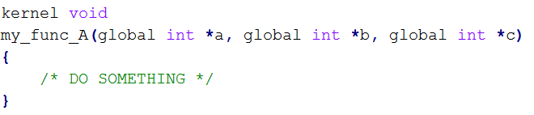
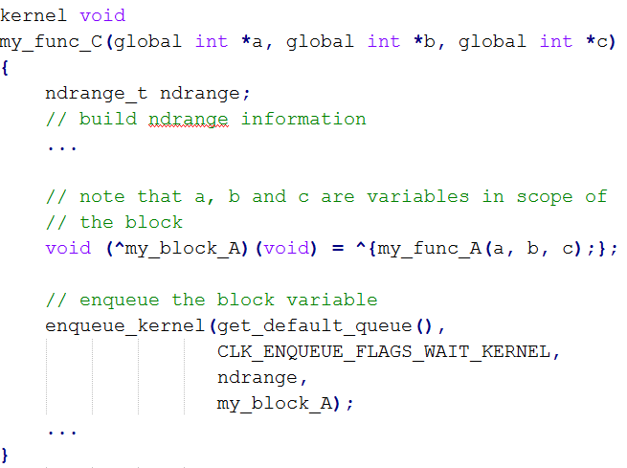
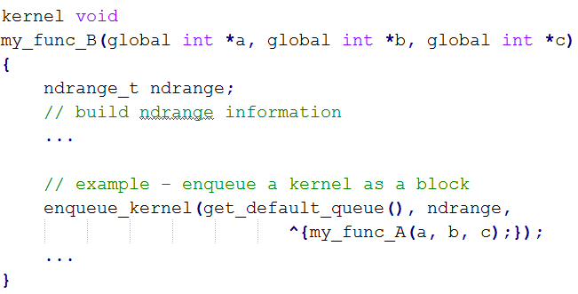
Device side enqueuer kernels

Slide 75
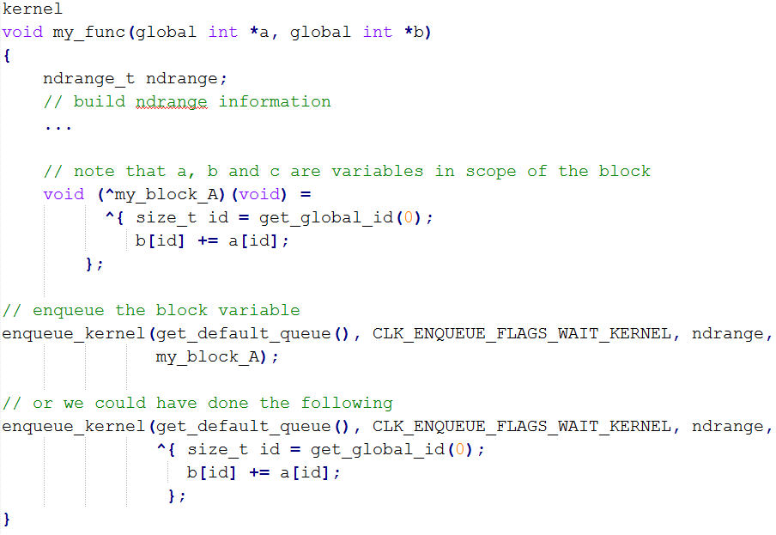
Device side enqueuer kernels

